Slide 1
Config https (SSL Local)
Web service Web Application

Slide 2



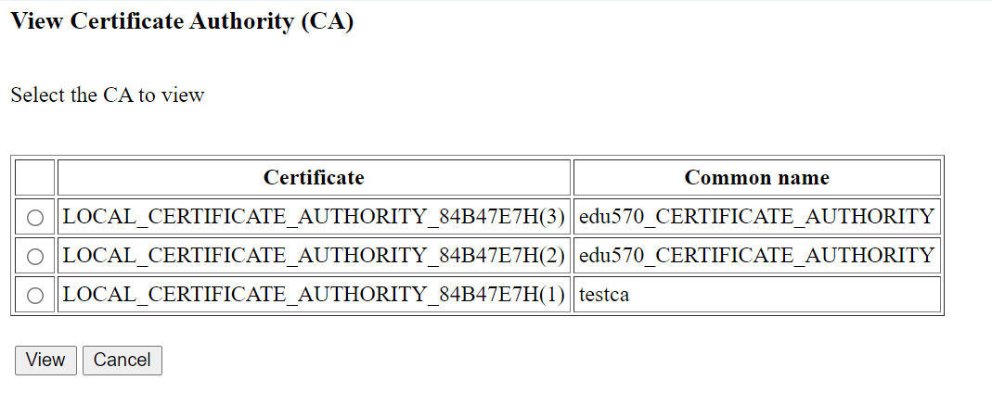
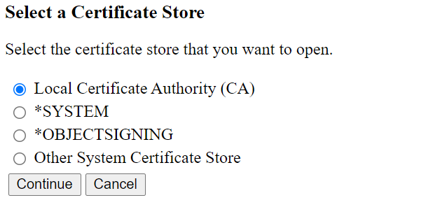
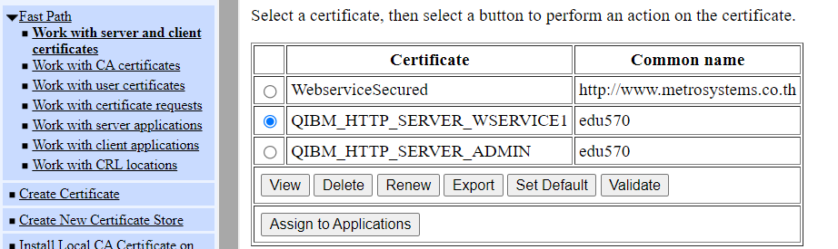
How to HTTPS
Client
5.Install CA to PC (.CRT)
3.1 Enable HTTP Security
Server
3. 2 Enable SSL in App. Server
1. Create Local Certificate Authority (CA)
4. Assign Certificate to Server Application
2. Create Local server certificate
1. Local Certificate Authority (CA)
2. *SYSTEM
Local server certificate
Creating a Local server certificate
inside an existing *SYSTEM store with an existing Local Certificate Authority (CA

Slide 3
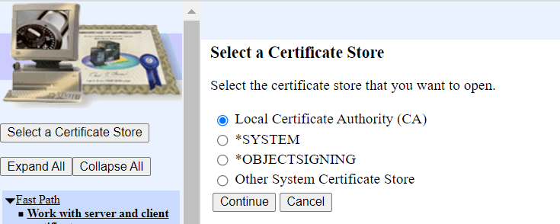
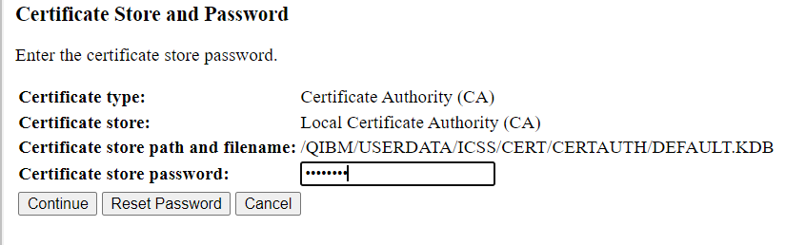
1. Create Local Certificate Authority (CA)
1. Select a Certificate Store with Local Certificate Authority (CA) and click continue
2. Enter a password and click continue

Slide 4
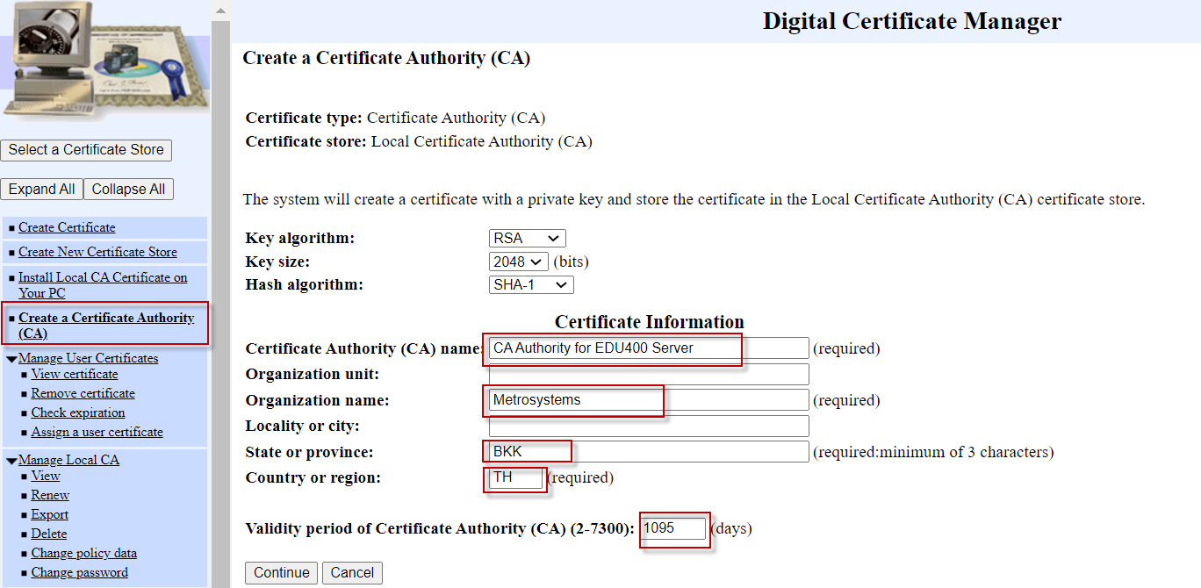
1. Create Local Certificate Authority (CA)
3. Select “Create a Certificate Authority (CA) ” on the left-menu and input required information and click continue

Slide 5
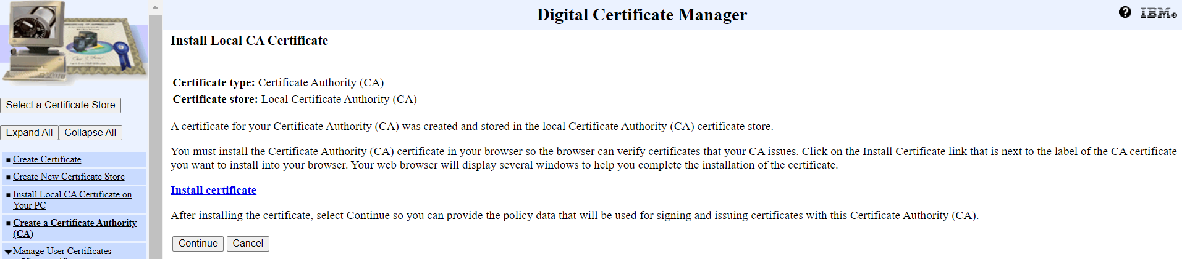
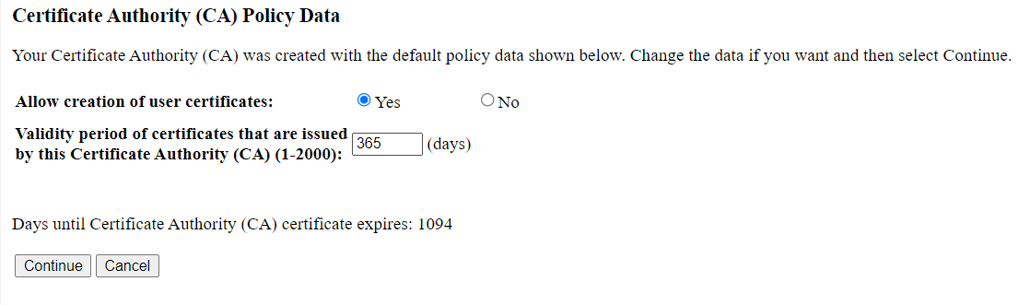
1. Create Local Certificate Authority (CA)
4. Install Certificate to verify certificated (Optional can install later) or Click Continue
5. Click Continue

Slide 6
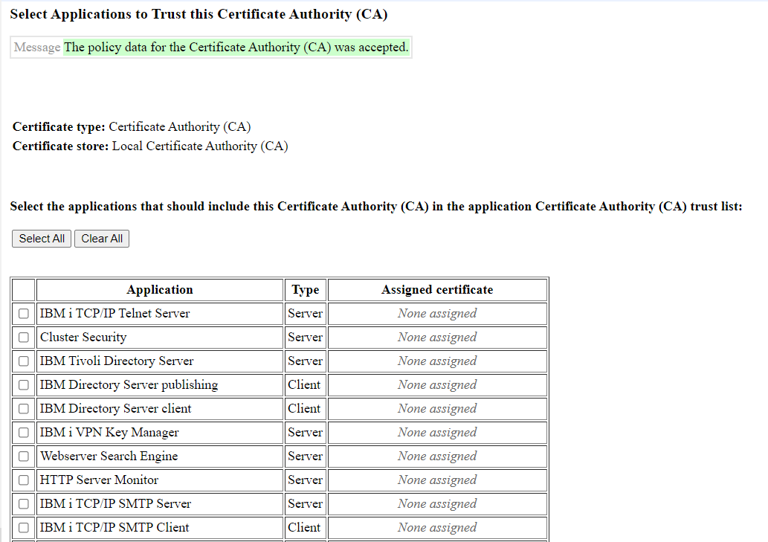
1. Create Local Certificate Authority (CA)
5. Click Continue to Trust this CA for Application Later

Slide 7
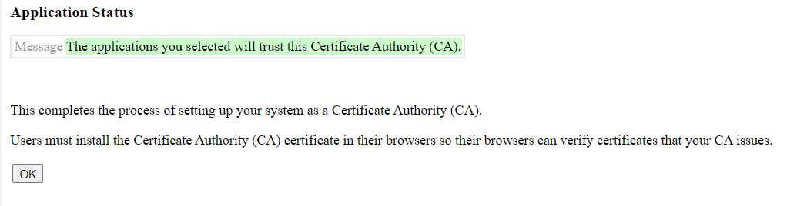
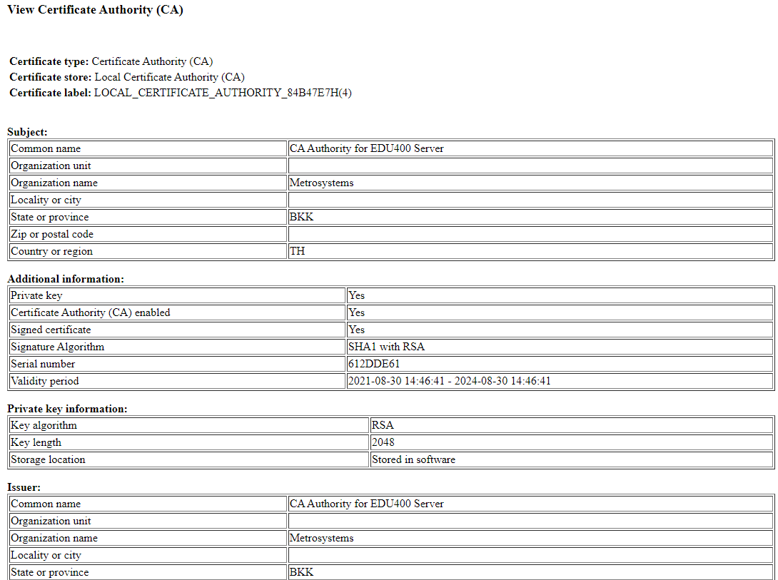
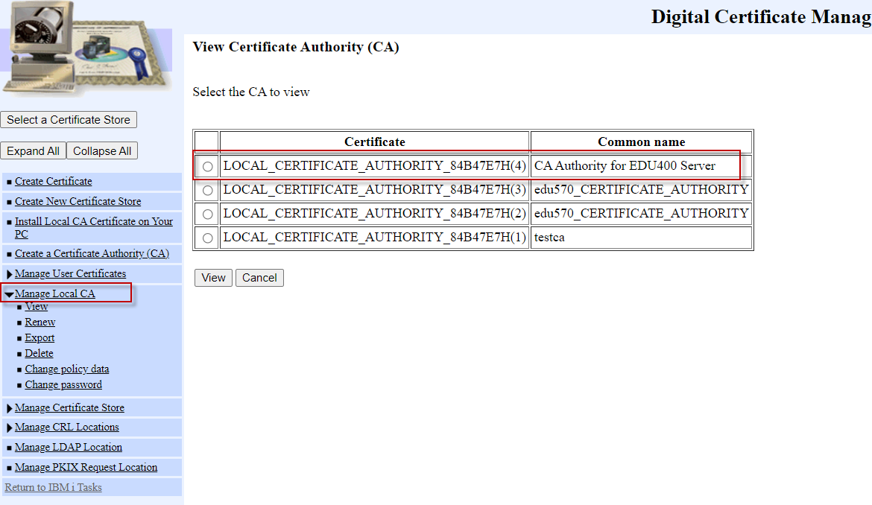
1. Create Local Certificate Authority (CA)
6. Completed the process Creating Local Certificate Authority (CA) and click OK
7. Select “Manage Local CA ” on the left-menu will shown the new CA is created

Slide 8
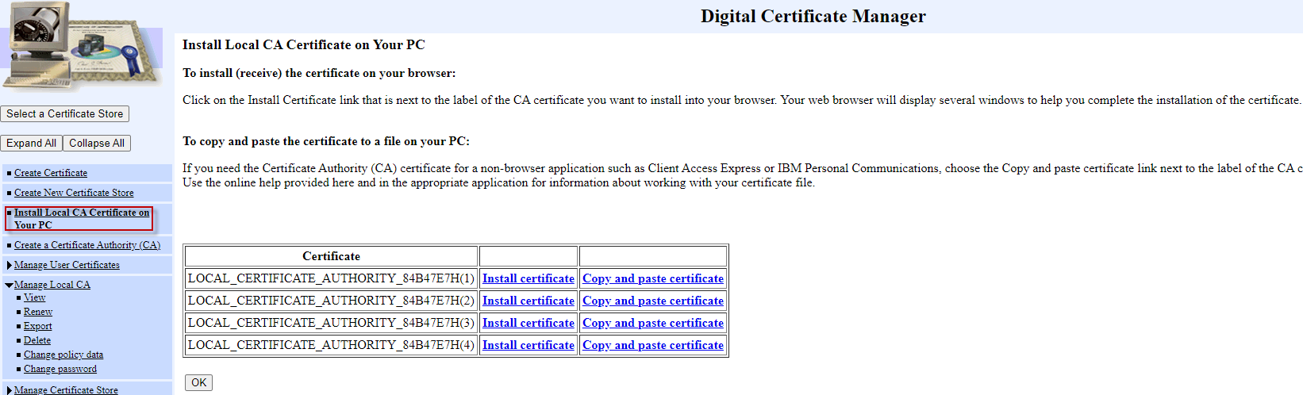
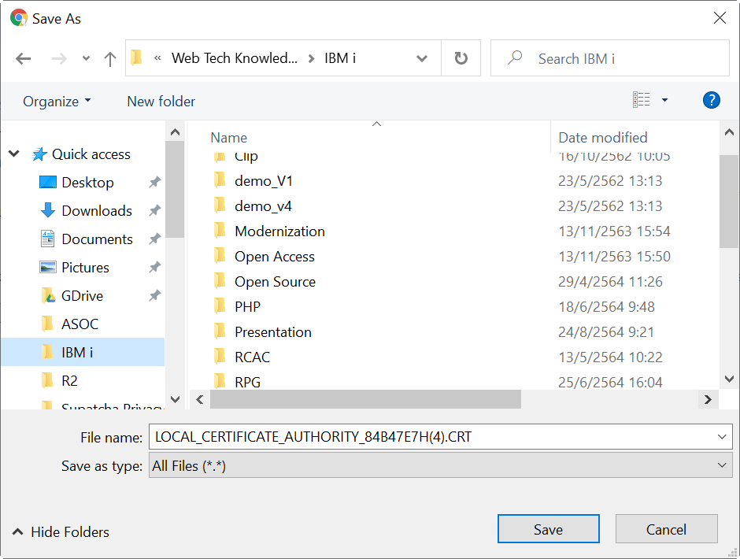
1. Create Local Certificate Authority (CA)
If want to download Local CA can go to “Install Local CA Certificate on Your PC ”
Download and Rename to .CRT

Slide 9
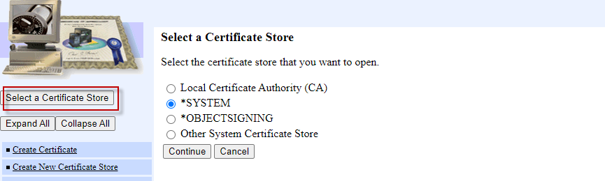
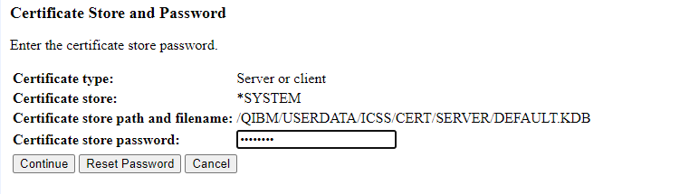
2. Create Local server certificate
1. Select a Certificate Store with *SYSTEM and click continue
2. Enter a password and click continue

Slide 10
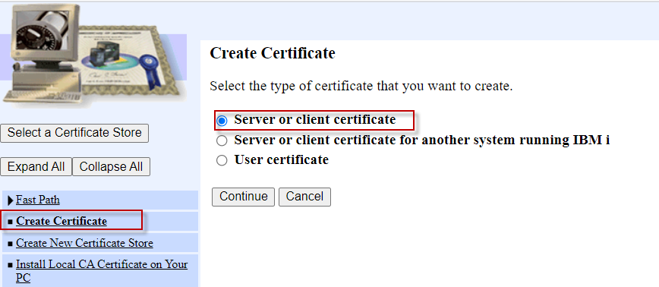
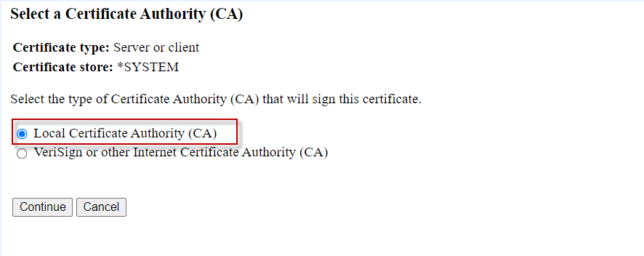
2. Create Local server certificate
3. Select “Create Certificate ” on the left-menu and then select “Sever or Client certificate” and click continue
4. Select “Local Certificate Authority (CA) ” and click continue

Slide 11
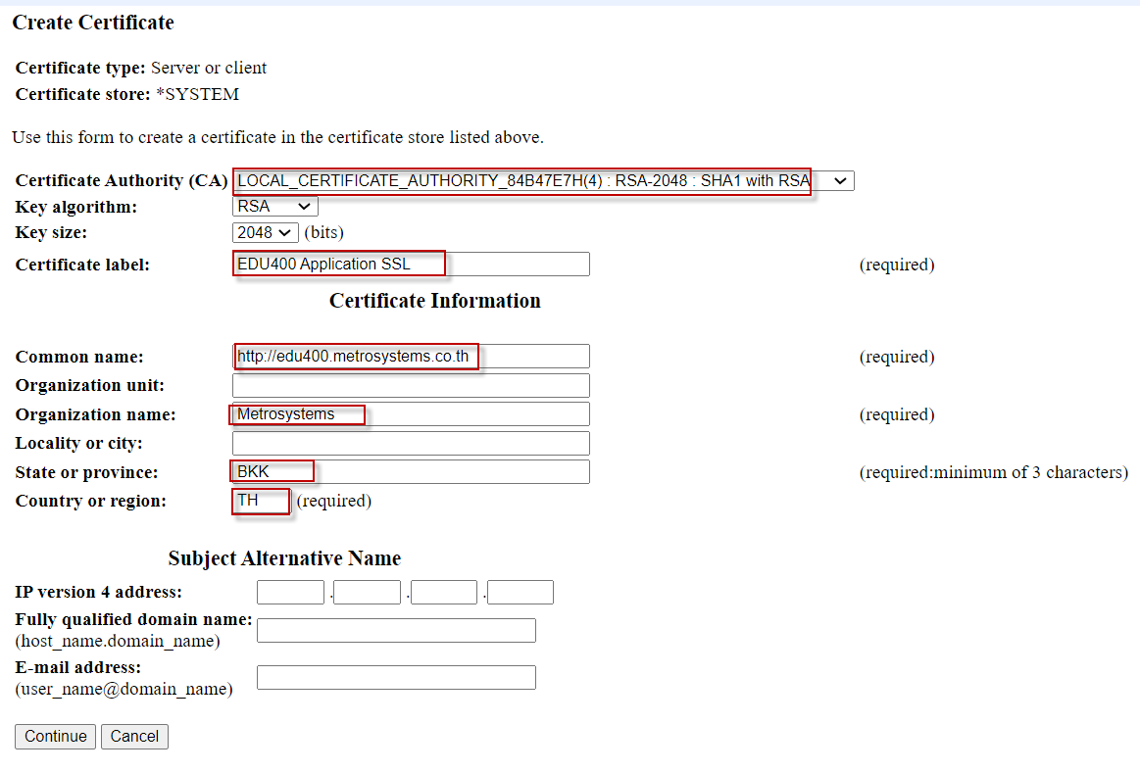
2. Create Local server certificate
5. Select “Local Certificate Authority (CA)” and input required information and click continue
This is the URL

Slide 12
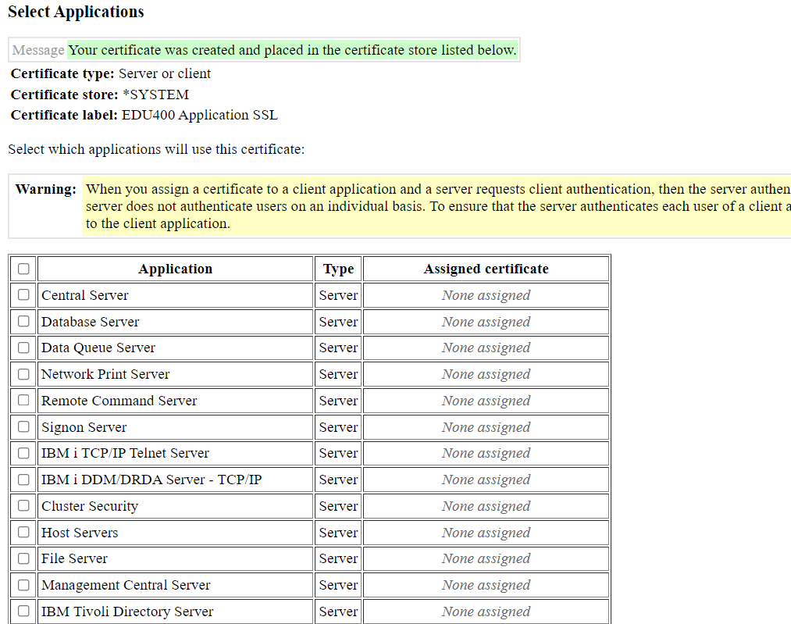
2. Create Local server certificate
6. Click Cancel to Select Application to assign this certificate Later

Slide 13
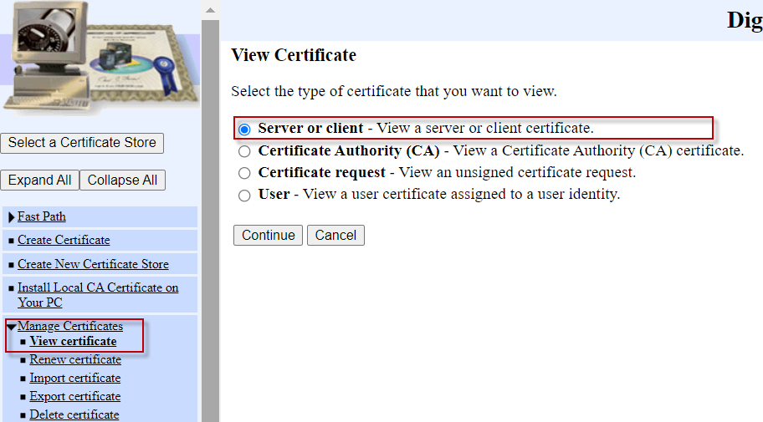
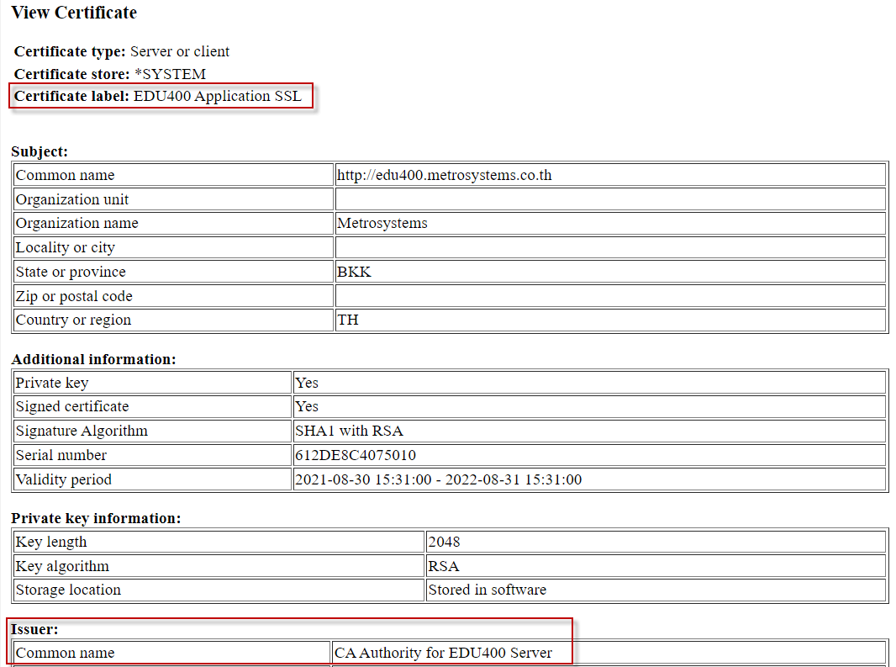
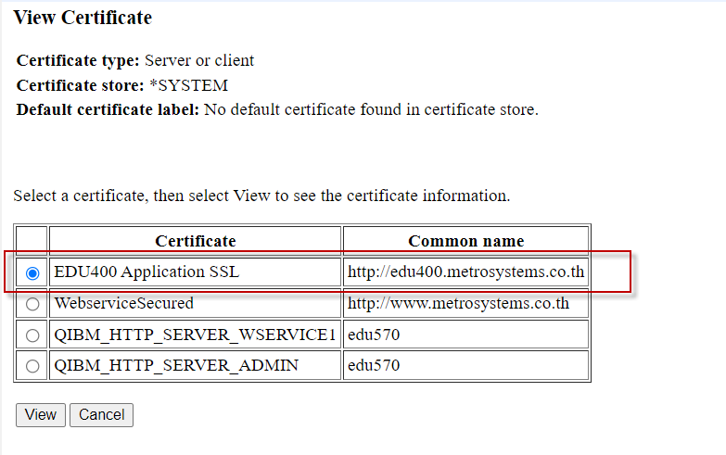
2. Create Local server certificate
7. Select “Manage Local CA ” on the left-menu and View Certificate and Select “Sever of client” and click continue
New Certificated is created
Link with Local Certificate CA

Slide 14
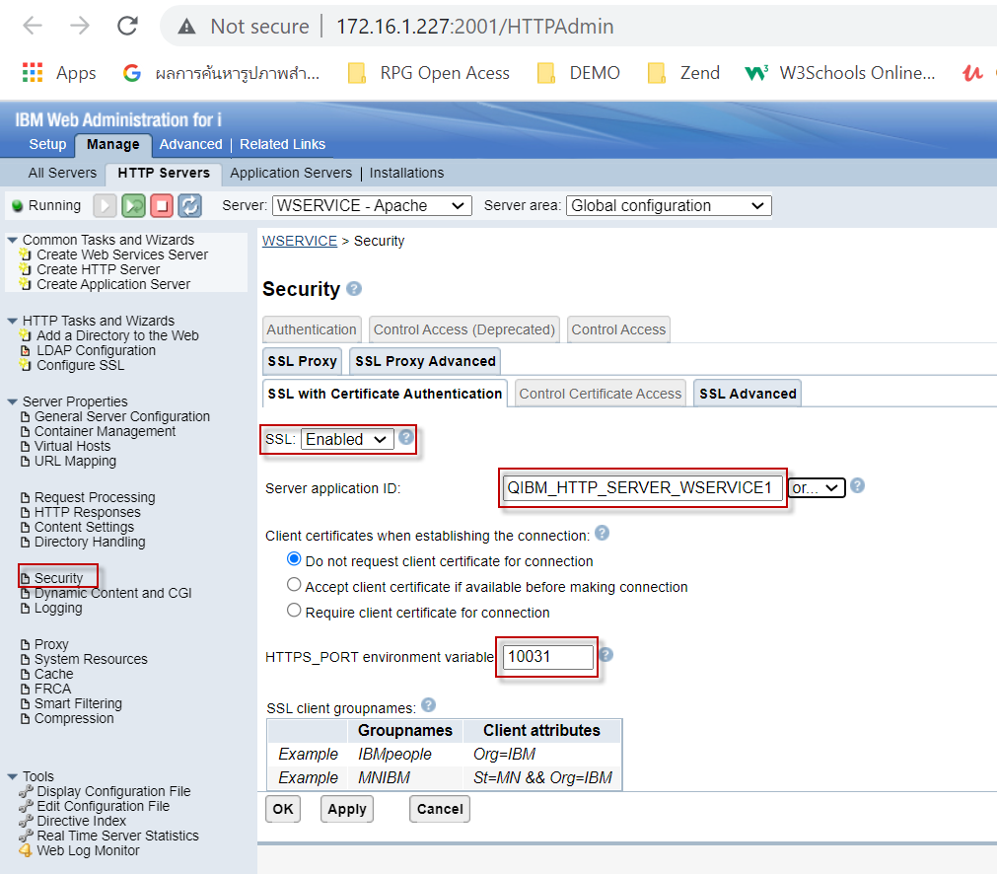
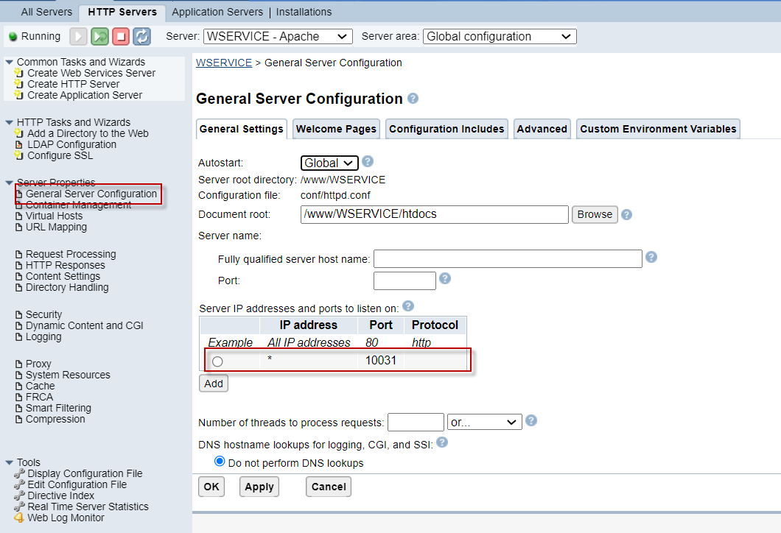
3.1 Enable HTTP Security in Apache server
Select “Security ” on the left-menu and
- Select SSL “Enabled”
- Select Server ID - Input HTTPS_PORT (Put in the default port of Application)
Default Port of Application

Slide 15
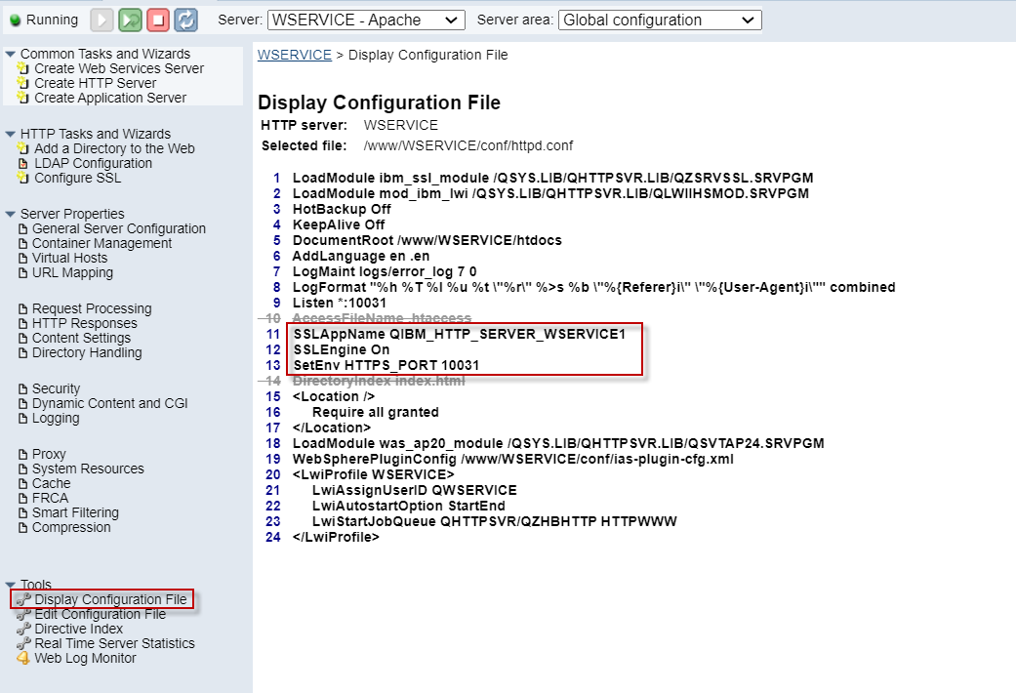
3.1 Enable HTTP Security in Apache server
2. Select “Display Configuration File ” on the left-menu and
Apache server configuration we now have the following three Apache directives
SSLEngin On
SSLAppName QIBM_HTTP_SERVER_WSERVICE1
SetEnv HTTPS_PORT 10031

Slide 16
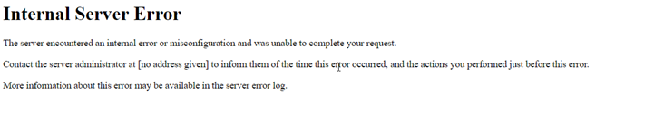
3.2 Enable SSL in Application server
For Web Services or DB2 Web Query or other application are running on WebSphere Application Server 8.5 or later Must manually config SSL at application server Will found web sphere’s error, if missing step enable SSL
Log path: Z:\www\{instance}\logs\plugin.txt
ERROR: ws_common: websphereFindTransport: Nosecure transports available
ERROR: ws_common: websphereWriteRequestReadResponse: Failed to find a transport
ERROR: ESI: getResponse: failed to get response: rc = 4

Slide 17
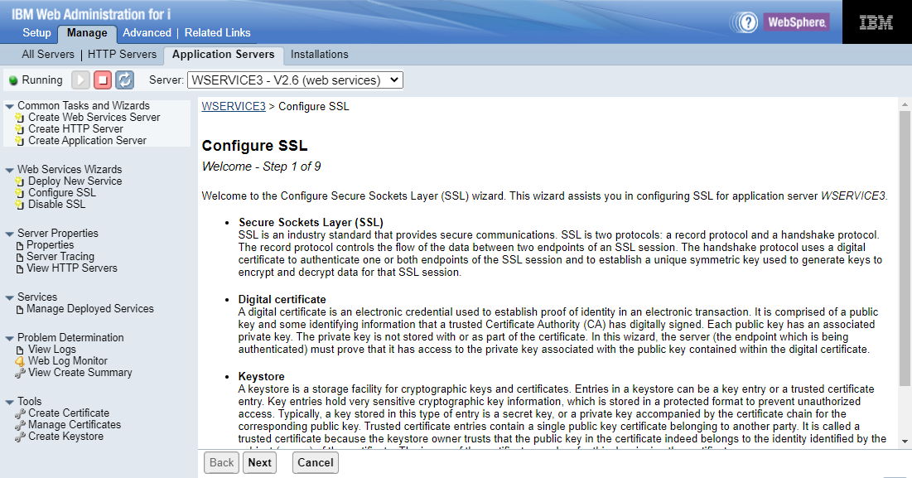
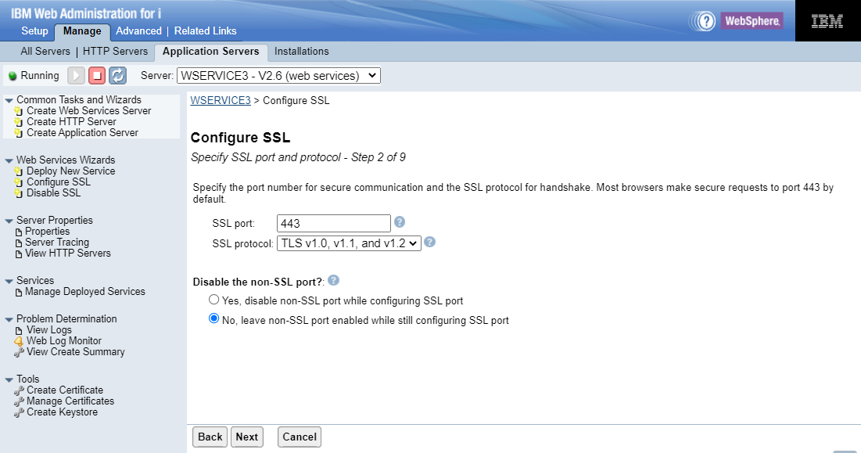
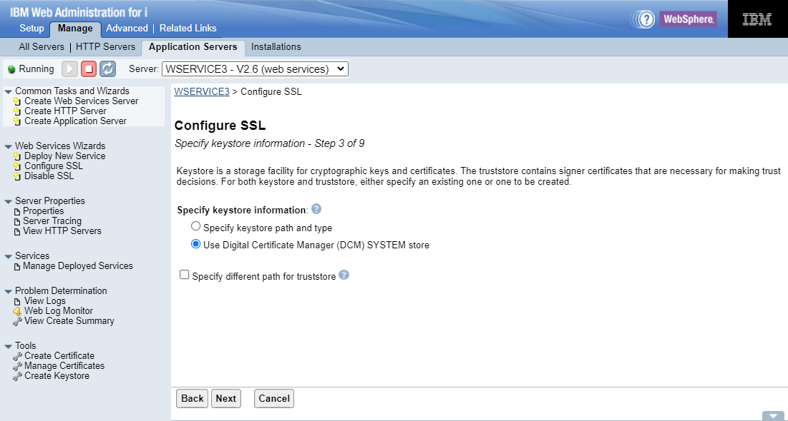
3. Enable HTTP Security in Apache server
Select Application Servers -> select Configure SSL

Slide 18

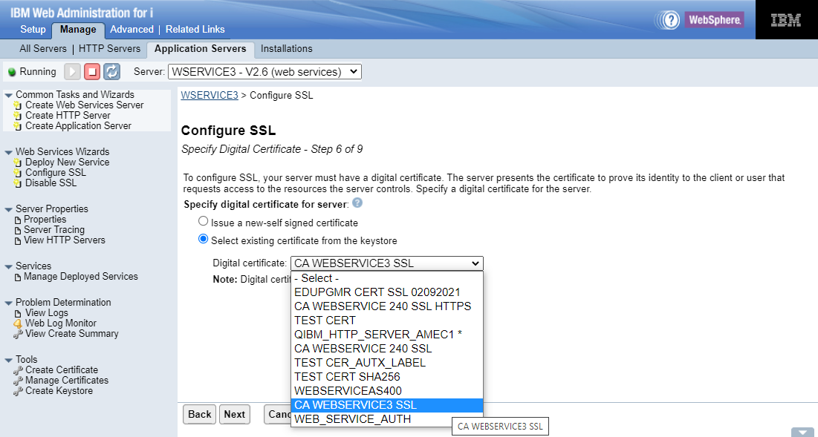
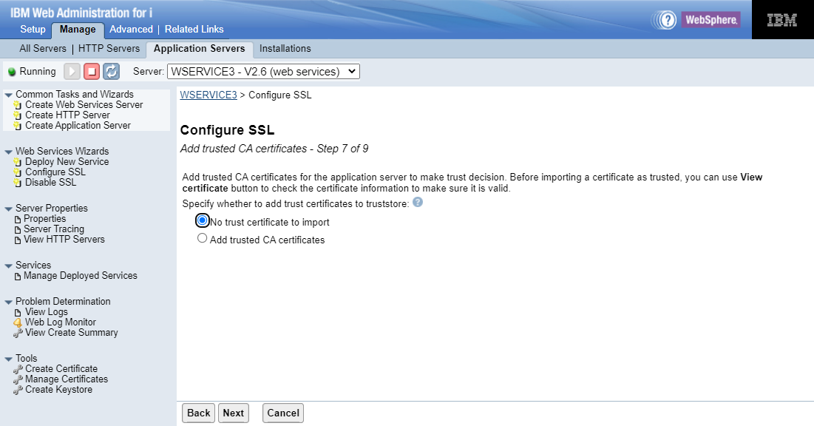
3. Enable HTTP Security in Apache server
Input password of *System store
Select Local digital certificated

Slide 19

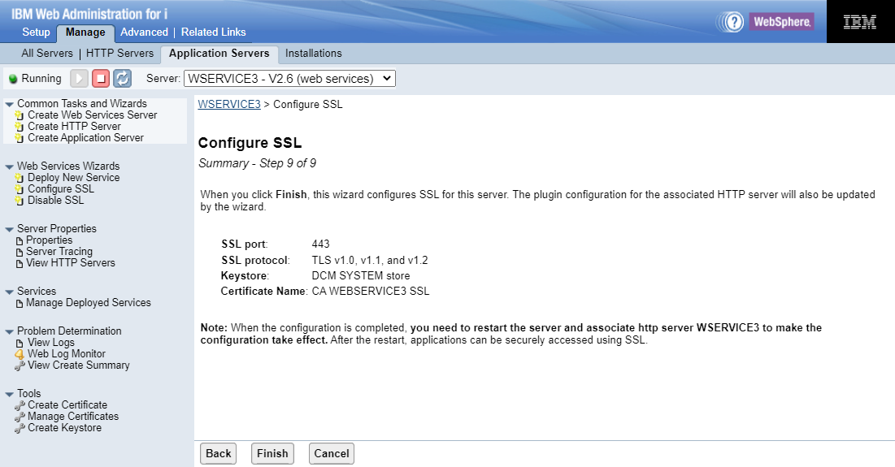
3. Enable HTTP Security in Apache server
Click Finish and restart Application server once

Slide 20
4. Assign certificate to Server Application
1. Select a Certificate Store with *SYSTEM and click continue
2. Enter a password and click continue

Slide 21
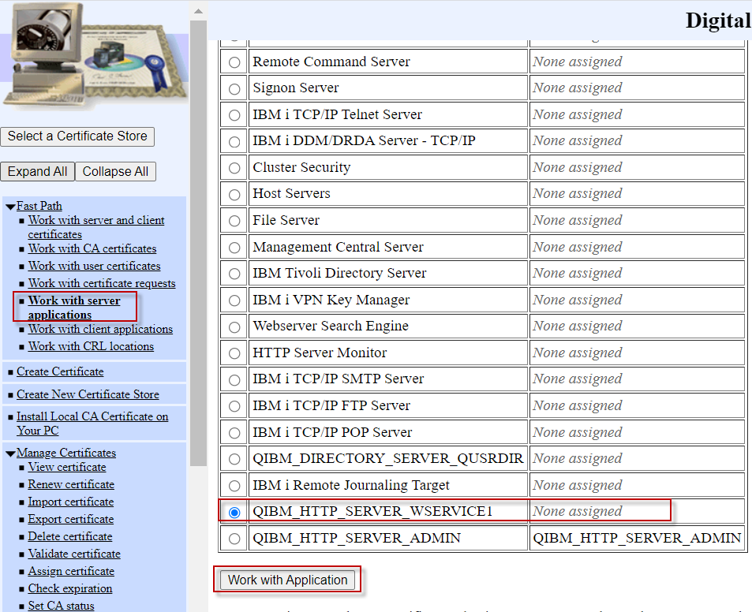
4. Assign certificate to Server Application
3. Select “Fast Path ” on the left-menu and then select “Work with server application” and Select Application ID and click Work with Application

Slide 22
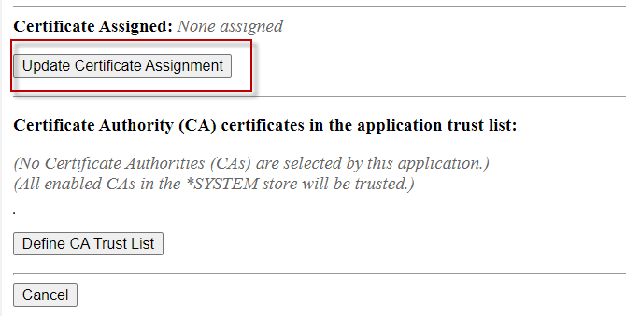
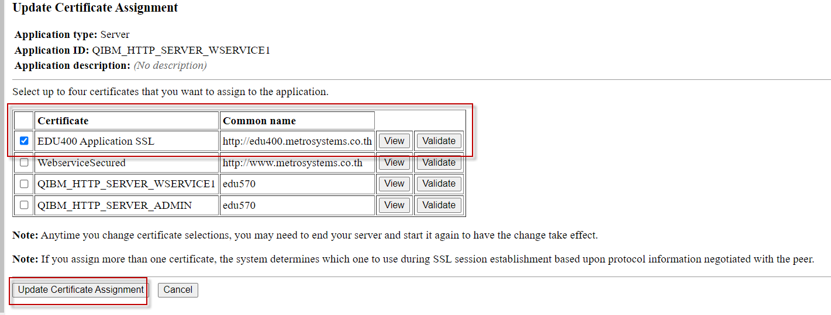
4. Assign certificate to Server Application
4. Scroll down to Certificate Assigned click “Update Certificated Assignment”
5. Select Certificate and click “Update Certificated Assignment”

Slide 23
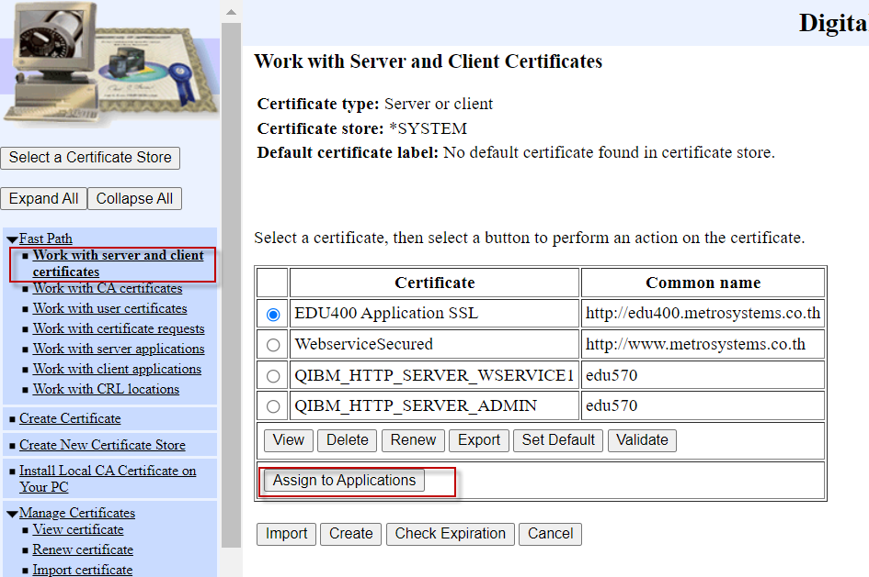
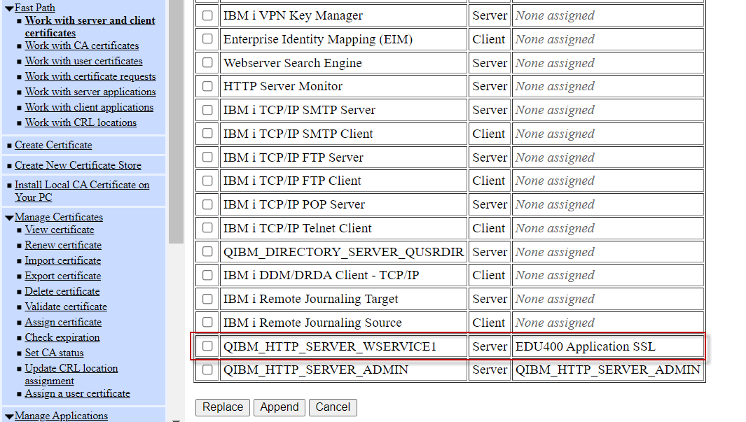
4. Assign certificate to Server Application
6. Back to menu Fast Path and select “Work with server and client application” and click Assign to Applications
Certificated assigned to application

Slide 24
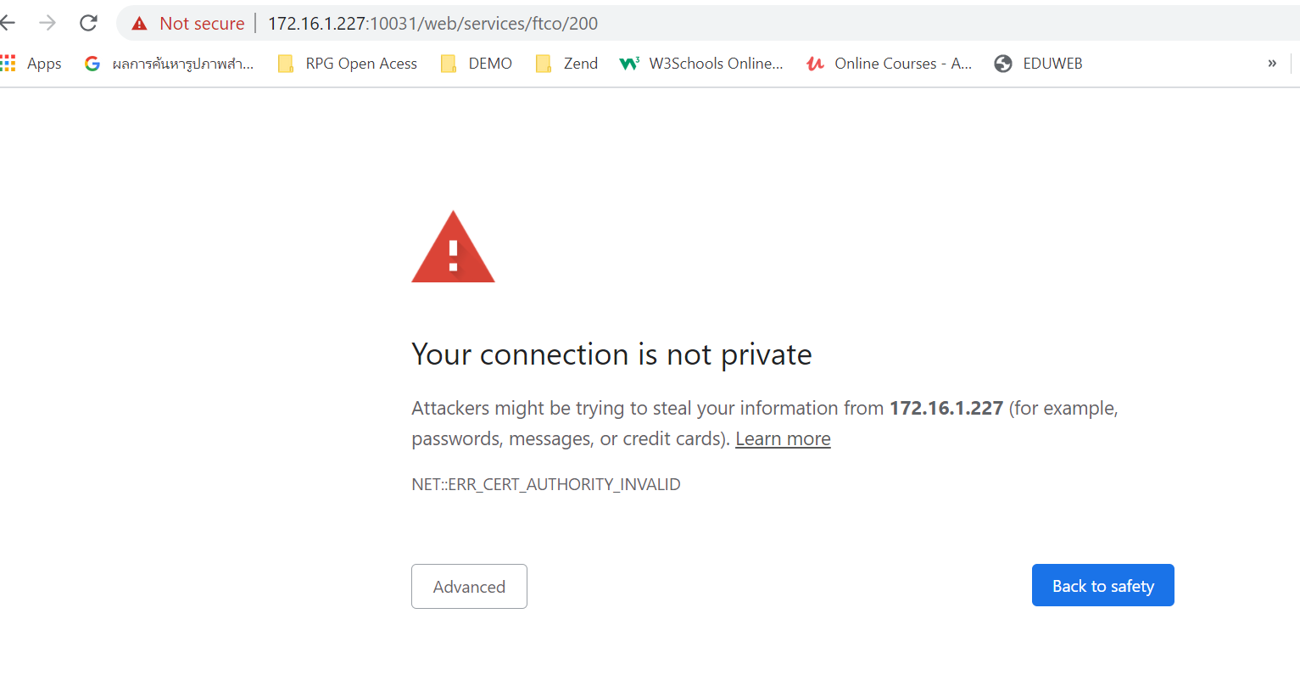
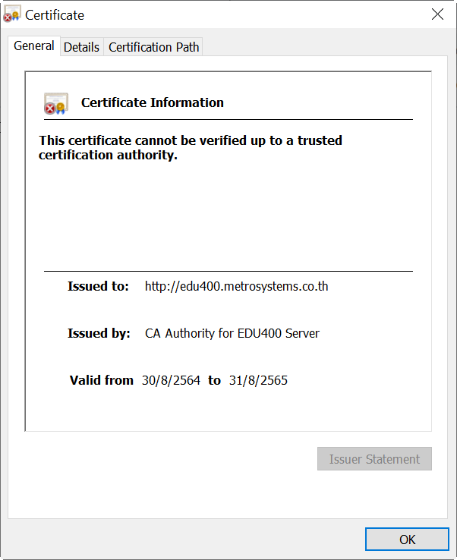
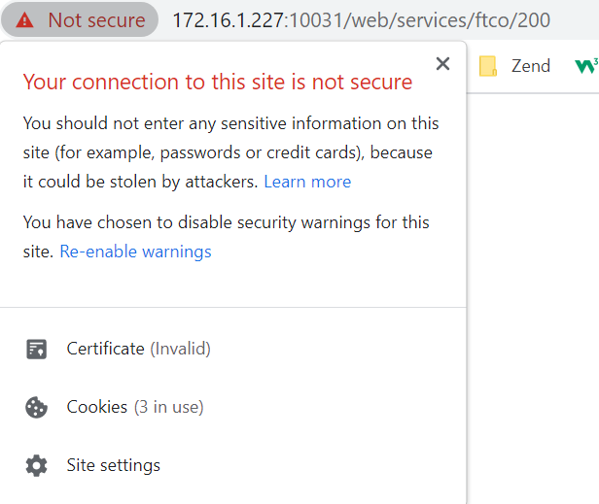
5. Test HTTPS
Restart HTTP Apache Server
Access via HTTPS and click Advanced and Proceed
3. HTTPS is working but not secure because certificate is not trusted

Slide 25
Config https (SSL Global)
Zend Server Web Application

Slide 26
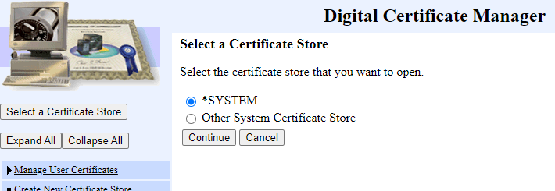
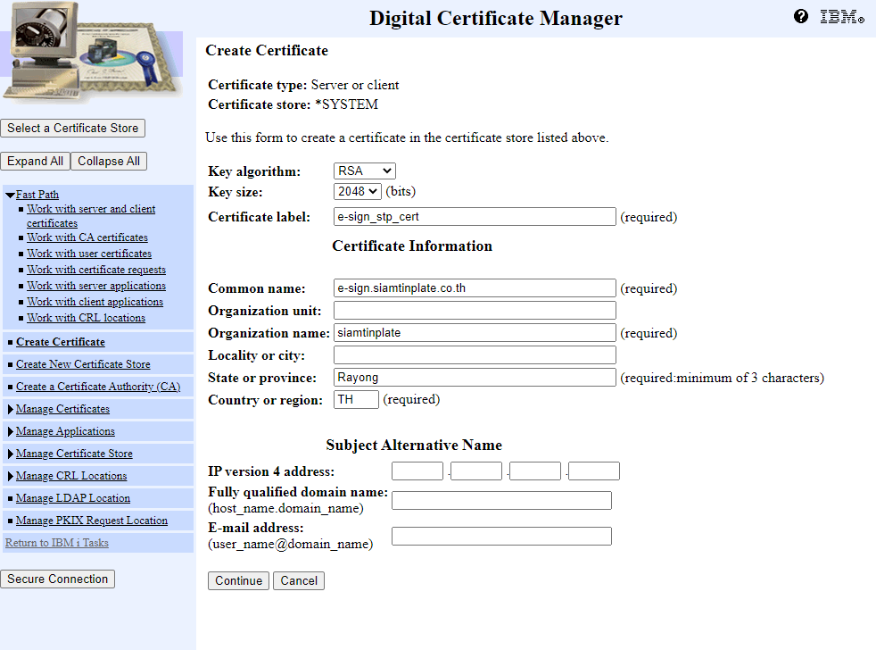
1. Create CSR (Certificate Signing request)
Select *System store
At Left menu select Create Certificate
-> select Sever or client certificate
-> select VeriSign or other Internet Certificate Authority (CA).
Then input required certification information.
* common name : Domain name of website

Slide 27
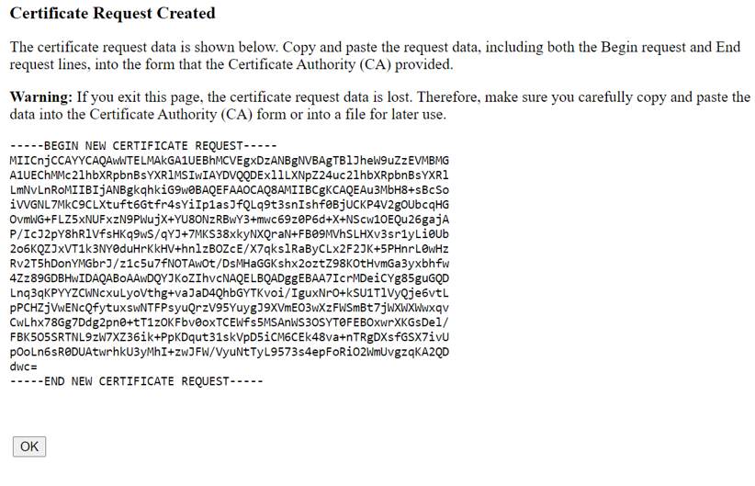
1. Create CSR (Certificate Signing request)
CSR key is generated, Must Copy CSR key to text file because after press ‘OK’ CSR key will be missing. Then sent CSR file to SSL provider

Slide 28
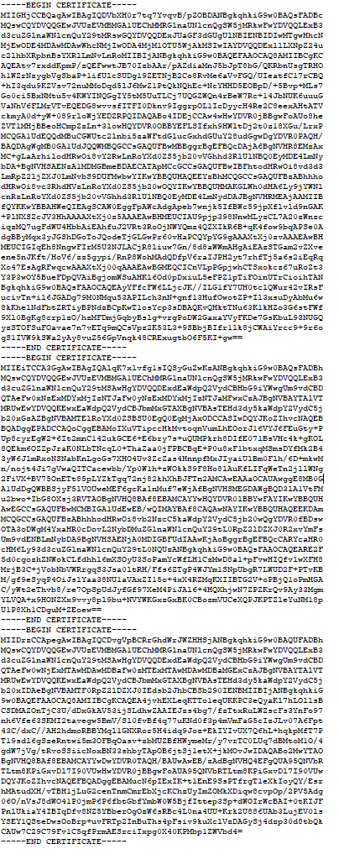
2. Receive key from provider
SSL Provider send back .pem file compose with 3 set of key
Copy to new file and rename 1.pem
Copy to new file and rename 2.pem
Copy to new file and rename 3.pem

Slide 29

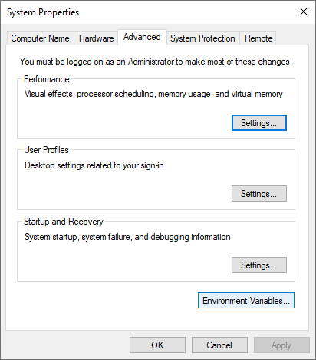
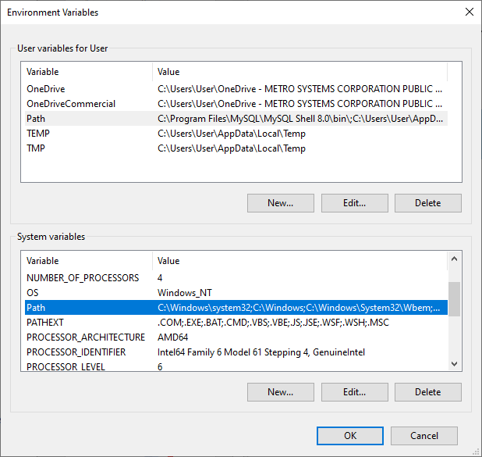
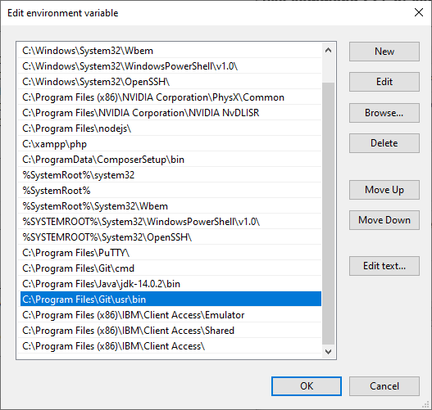
2. Receive key from provider
Install OpenSSL program from this link -> https://slproweb.com/products/Win32OpenSSL.html
Setup environment path for use command SSL at command line

Slide 30
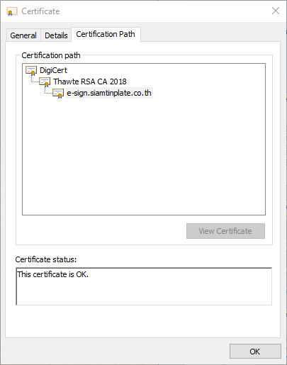
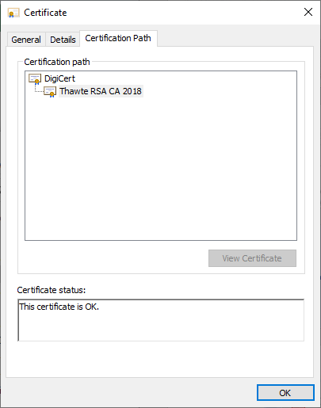

2. Receive key from provider
Convert key from .pem file to .crt file and rename crt file
- openssl x509 -outform der -in 1.pem -out 1.crt
- openssl x509 -outform der -in 2.pem -out 2.crt
- openssl x509 -outform der -in 3.pem -out 3.crt
1.crt -> e-sign.siamtinplate.co.th.crt
2.crt -> TrustCA.crt
3.crt -> CARoot.crt

Slide 31

3. Import certification from provide to server
Paste certification to server folder
Select *System store

Slide 32








3. Import CARoot certification from provide to server
Select Manage certificates store -> select Import certificate
CARoot.crt
TrustCA.crt
e-sign.siamtinplate.co.th.crt (domain key)
After complete import domain key, CSR Key will be missing from server

Slide 33




3. Import CARoot certification from provide to server
CA Certification import successfully, select Manage certificates store -> select Import certificate
CARoot.crt
TrustCA.crt

Slide 34


4. Enable SSL
Config http at Zend server

Slide 35



4. Enable SSL
Review http configuration

Slide 36




5. Assign certification to application ID
Select Fast Path -> select Work with server application -> select application QIBM_HTTP_SERVER_ZENDPHP7

Slide 37
6. Config .htaccess to re-direct from http to https
When access with http can automatically forward to https
<IfModule mod_rewrite.c>
RewriteEngine On
RewriteCond %{REQUEST_URI} !^/stp-web
RewriteRule ^(.*)$ /stp-web/$1 [NC,L]
RewriteCond %{HTTPS} off
RewriteRule (.*) https://%{HTTP_HOST}%{REQUEST_URI} [L,R=301]
</IfModule>

Slide 38


7. Access application with http then re-direct to https

